Slide 1
Starter Unit
Let’s start with something new!

Slide 2
Did you finish your homework?

Slide 3
Story Time Review Let’s read aloud!!!!
Turn to P1

Slide 4
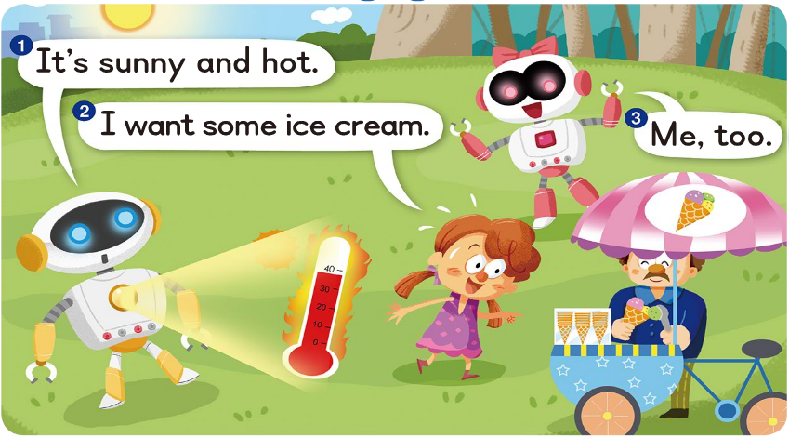

Slide 5
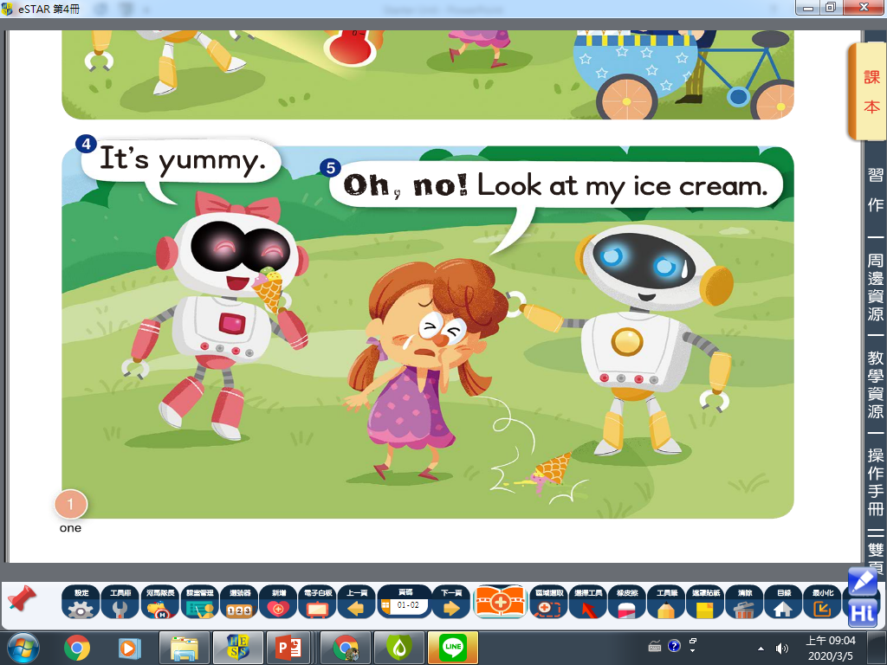

Slide 6
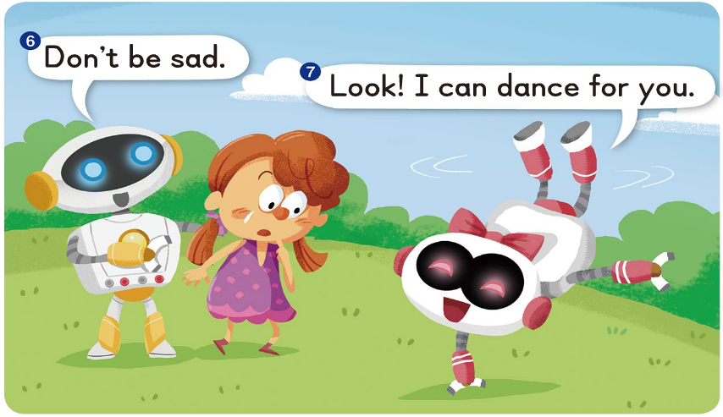

Slide 7
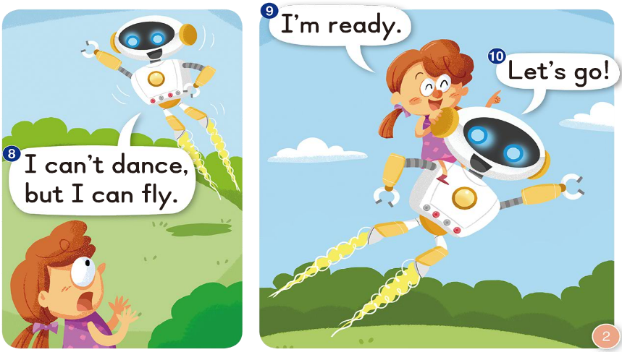

Slide 8
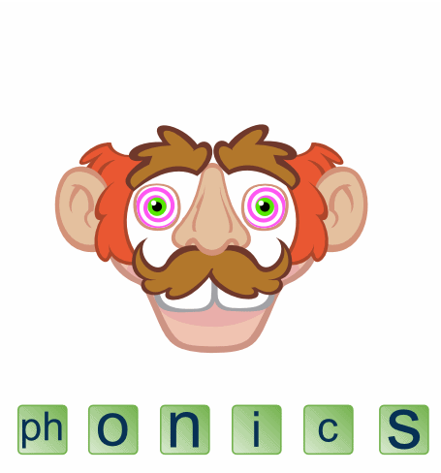
Phonics Time P3~4

Slide 9
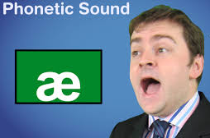
a
a
e

Slide 10
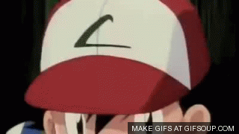
c
p
a

Slide 11
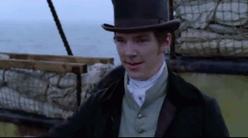
h
t
a

Slide 12
c
n
a

Slide 13
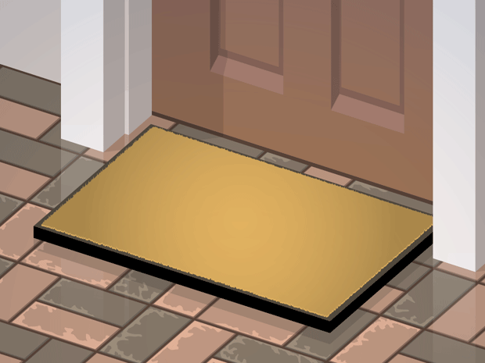
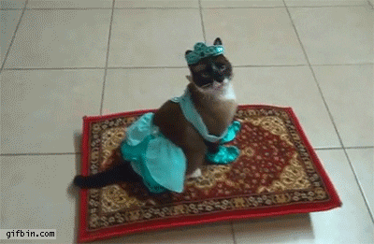
m
t
a

Slide 14
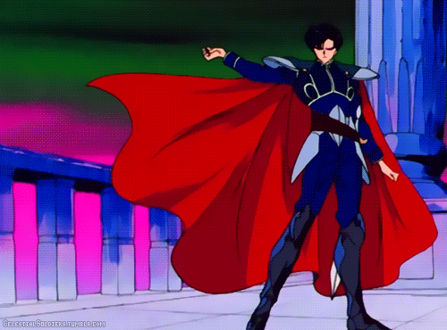
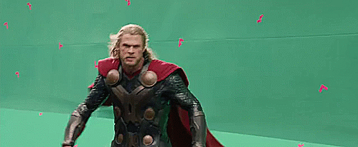
c
p
a
e

Slide 15
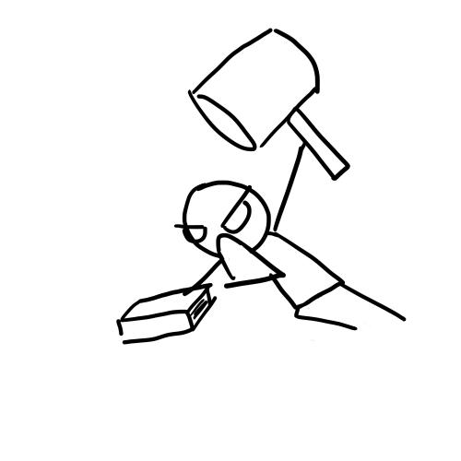
h
t
a
e

Slide 16
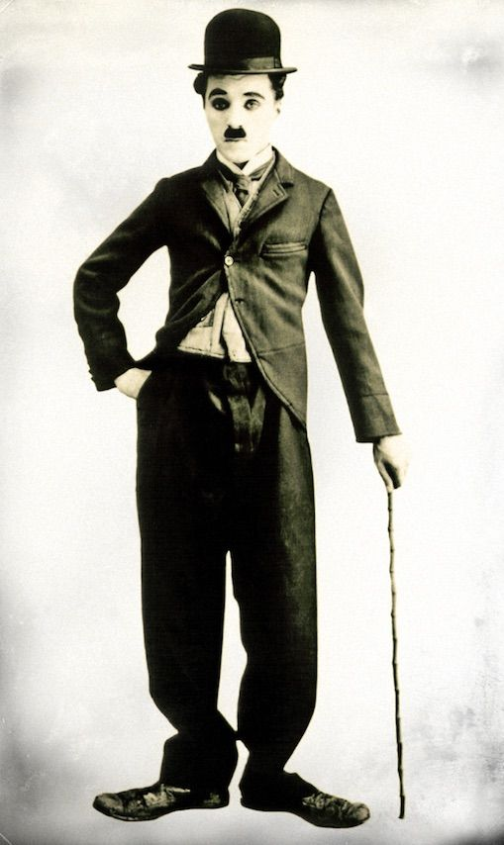
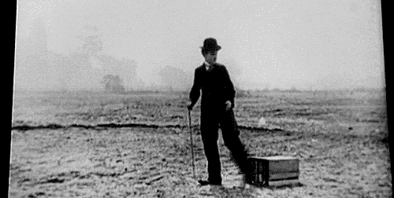
c
n
a
e
查爾斯·卓別林爵士
Sir Charles Chaplin

Slide 17
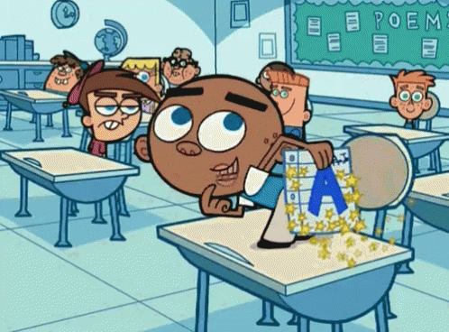
m
t
a
e

Slide 18
a
a
e
cap cape
hat hate
can cane
mat mate

Slide 20
Sam has a cap.

Slide 21
Kate has a hat.

Slide 22
Sam and Kate dance with a cane.

Slide 23
They win the game and get a cape.

Slide 24
Sam has a cap.
Kate has a hat.
Sam and Kate dance with a cane.
They win the game and get a cape.

Slide 26
a
e
a

Slide 27
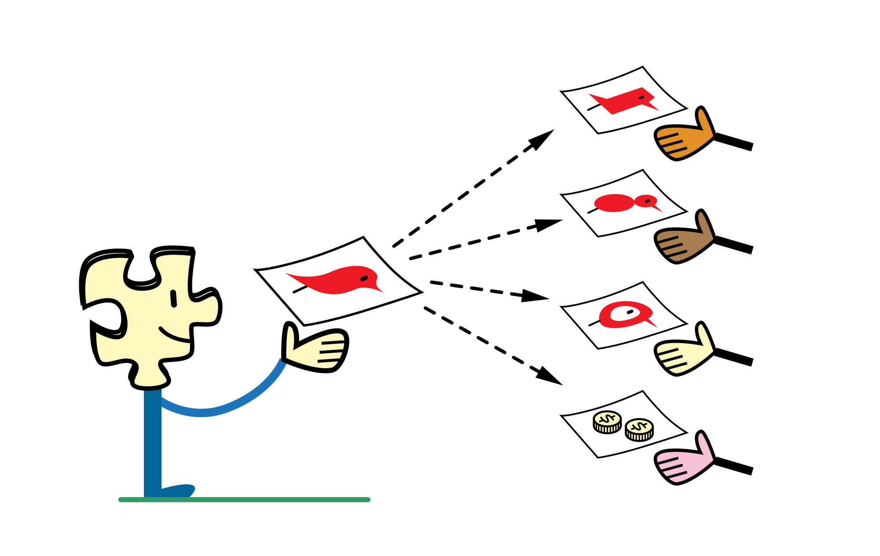
Challenge!!!
Listen and hand out the answer!

Slide 28
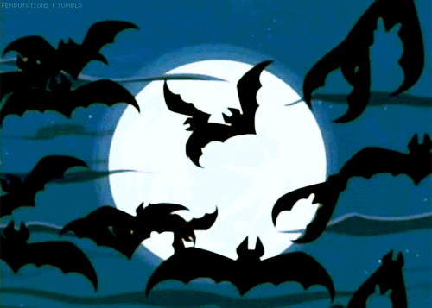

Slide 29
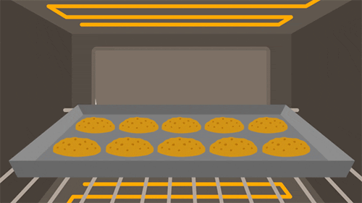

Slide 30
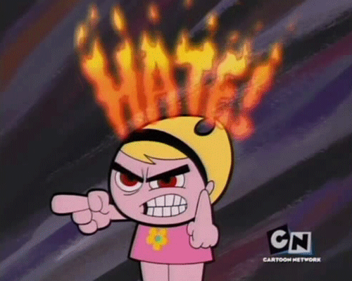

Slide 31
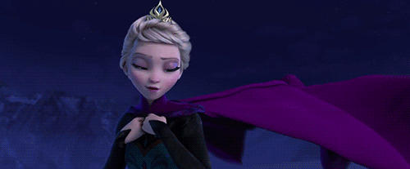

Slide 32
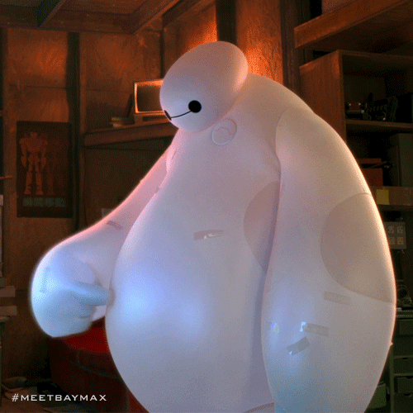

Slide 33
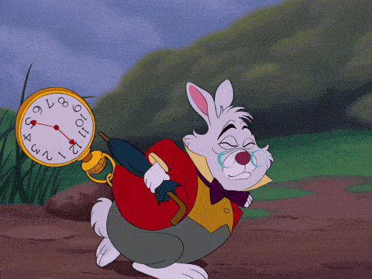

Slide 34
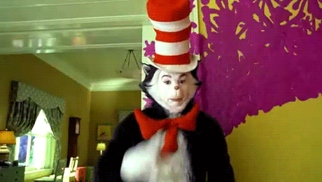

Slide 36
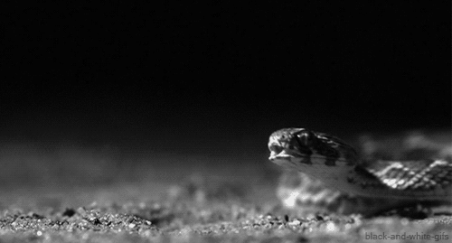

Slide 38
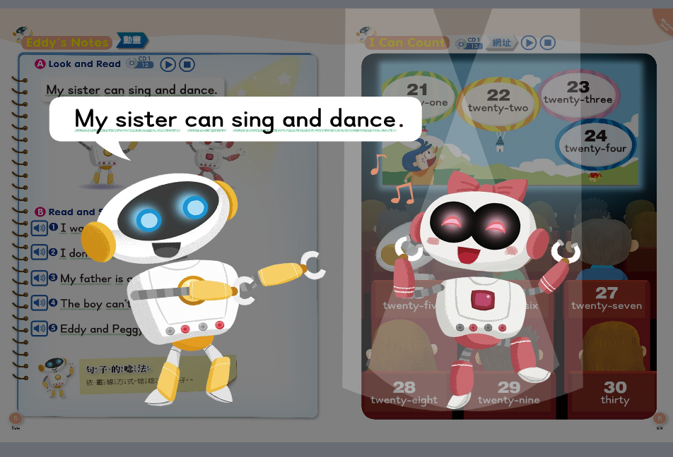

Slide 39
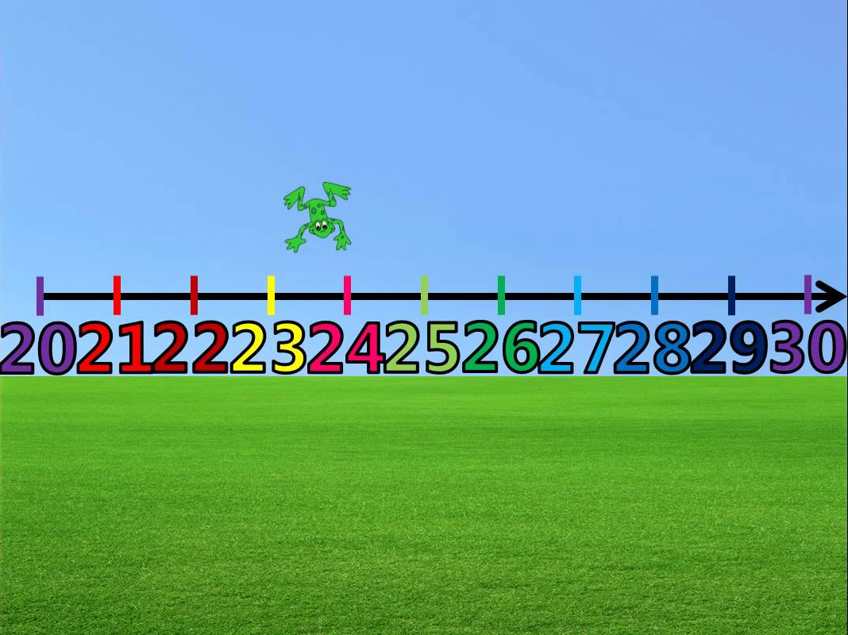
Let’s count! P6

Slide 40
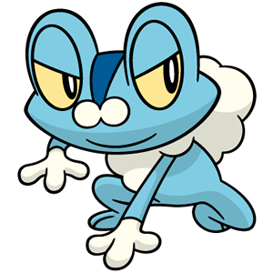
twenty

Slide 41
thirty

Slide 42
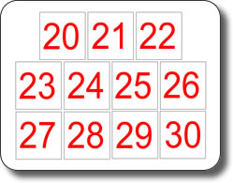
twenty
twenty-one
twenty-two
twenty-three
twenty-four
twenty-five
twenty-six
twenty-seven
twenty-eight
twenty-nine
thirty

Slide 43
Let’s learn Pokémon theme song!
Gotta = got to
意思是「必須」去做某事
'em＝them

Slide 45
Listen and write.

Slide 46
Let’s check the answers!
I want to be the very best,
Like no one ever was.
To catch them is my real test,
To train them is my cause.

Slide 47
I will travel across the land,
Searching far and wide.
Teach Pokémon, to understand
The power that's inside

Slide 48
Pokémon (Gotta Catch 'em all)
It's you and me
I know it's my destiny
Pokémon!
You're my best friend
In a world we must defend

Slide 49
Pokémon (Gotta Catch 'em all)
A heart so true
Our courage will pull us through
You teach me and I'll teach you
Pokémon (Gotta catch 'em all)
Gotta catch 'em all

